Slide 1

LAPTOP STAND & LAPTOP STAND WITH HUBS

Slide 2
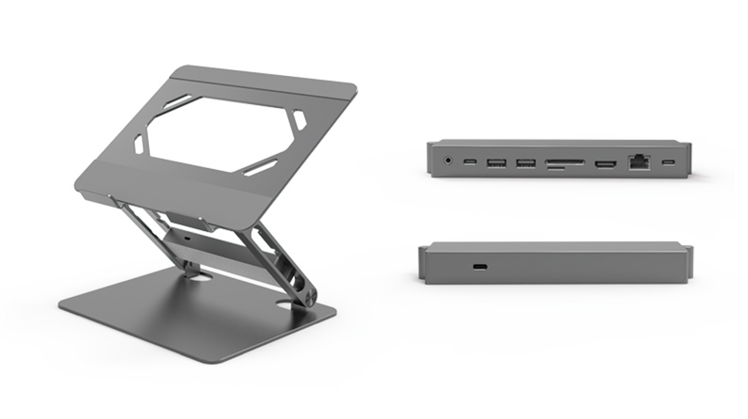
EILI: 9 in 1Universal Adjustable Ergonomic Laptop Riser Docking Station with USB-C, USB-A*2, HDMI 4K30, PD, RJ45, SD/TF, Audio, Tabletop Desk Stand Power Hubs, Laptop Riser Compatible for 10-17" Laptop
Brand | EILI or Private Label
Color | Space Gray; Silver; Dark Black are available
Hardware Interface | Ethernet, Type C, HDMI, USB 3.0, Audio, SD/TF
Compatible Devices | MacBook Pro, MacBook Air, Dell, HP, Surface, Lenovo
Total USB Ports | 2
Dimensions | 10.24 x 8.86 x 1.97 inches
Number of Ports | 9
Total HDMI Ports | 1
Wattage | 100.0 watts

Slide 3
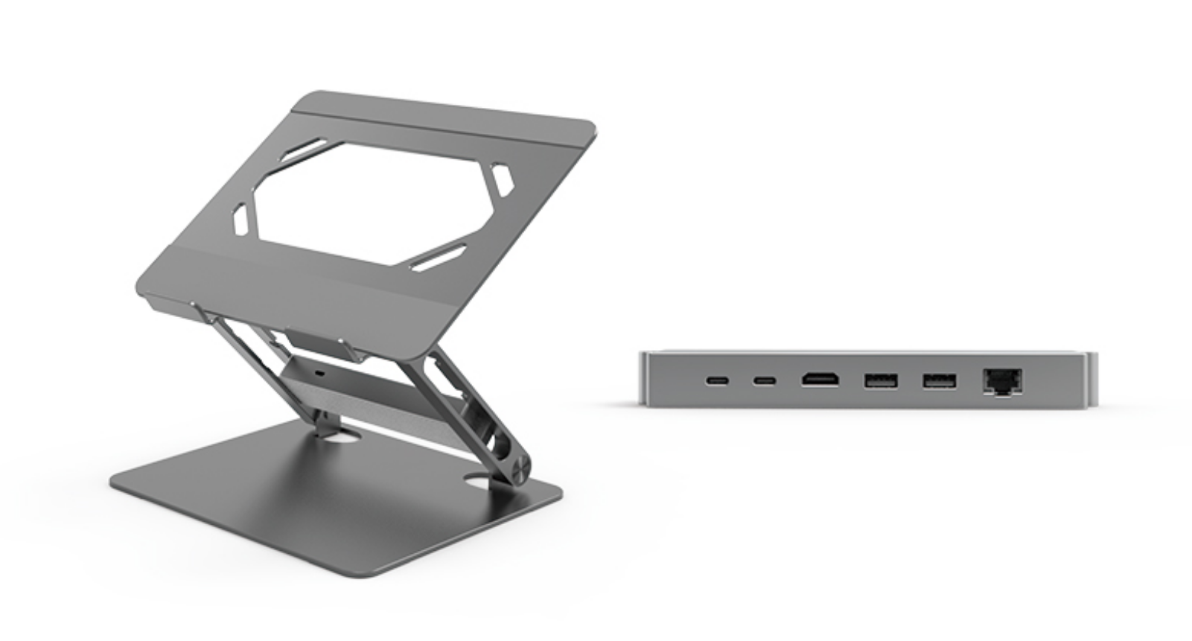
EILI: 6 in 1Universal Adjustable Ergonomic Laptop Riser Docking Station with PD USB-C*2, USB-A*2, HDMI 4K30, RJ45, Tabletop Desk Stand Power Hubs, Laptop Riser Compatible for 10-17" Laptop
Brand | EILI or Private Label
Color | Space Gray; Silver; Dark Black are available
Hardware Interface | Ethernet, Type C, HDMI, USB 3.0,
Compatible Devices | MacBook Pro, MacBook Air, Dell, HP, Surface, Lenovo
Total USB Ports | 2
Dimensions | 10.24 x 8.86 x 1.97 inches
Number of Ports | 6
Total HDMI Ports | 1
Wattage | 100.0 watts

Slide 4
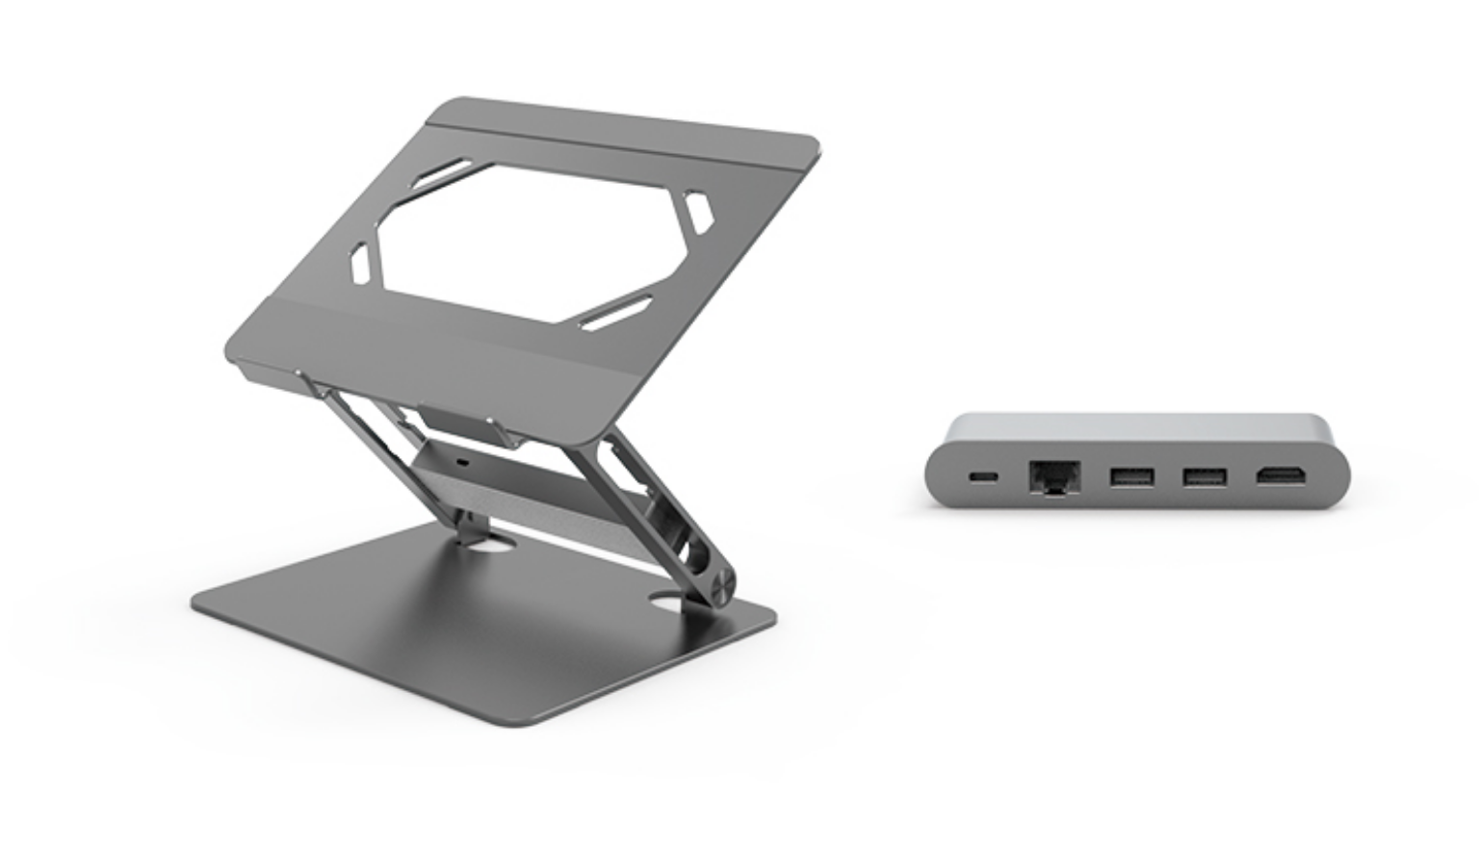
EILI: 5 in 1Universal Adjustable Ergonomic Laptop Riser Docking Station with USB-C, USB-A*2, HDMI 4K30, PD, RJ45, Tabletop Desk Stand Power Hubs, Laptop Riser Compatible for 10-17" Laptop
Brand | EILI or Private Label
Color | Space Gray; Silver; Dark Black are available
Hardware Interface | Ethernet, Type C, HDMI, USB 3.0,
Compatible Devices | MacBook Pro, MacBook Air, Dell, HP, Surface, Lenovo
Total USB Ports | 2
Dimensions | 10.24 x 8.86 x 1.97 inches
Number of Ports | 5
Total HDMI Ports | 1
Wattage | 100.0 watts

Slide 5
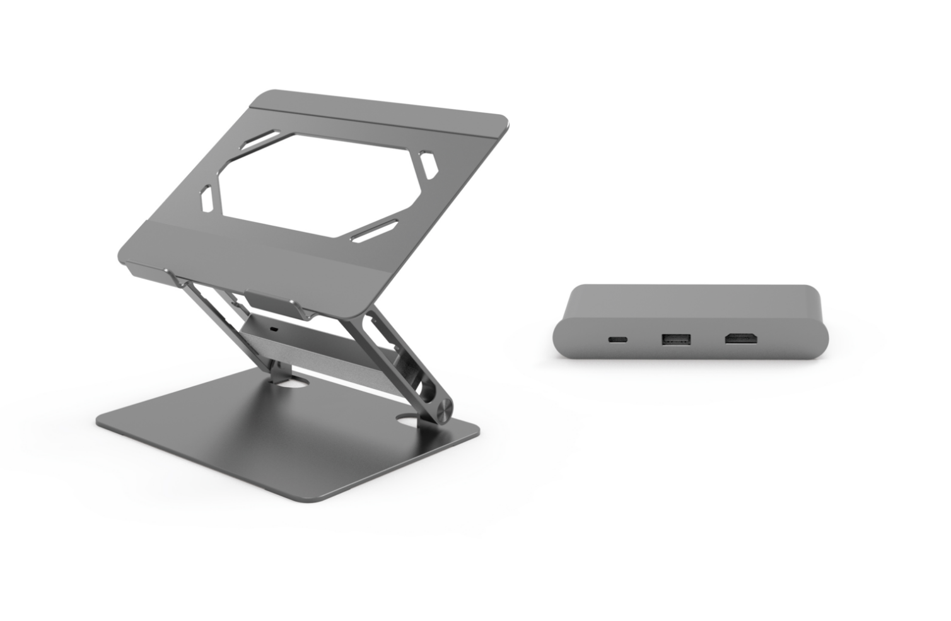
EILI: 3 in 1Universal Adjustable Ergonomic Laptop Riser Docking Station with USB-C, USB-A, HDMI 4K30, Tabletop Desk Stand Power Hubs, Laptop Riser Compatible for 10-17" Laptop
Brand | EILI or Private Label
Color | Space Gray; Silver; Dark Black are available
Hardware Interface | Type C, HDMI, USB 3.0,
Compatible Devices | MacBook Pro, MacBook Air, Dell, HP, Surface, Lenovo
Total USB Ports | 1
Dimensions | 10.24 x 8.86 x 1.97 inches
Number of Ports | 3
Total HDMI Ports | 1
Wattage | 100.0 watts

Slide 6
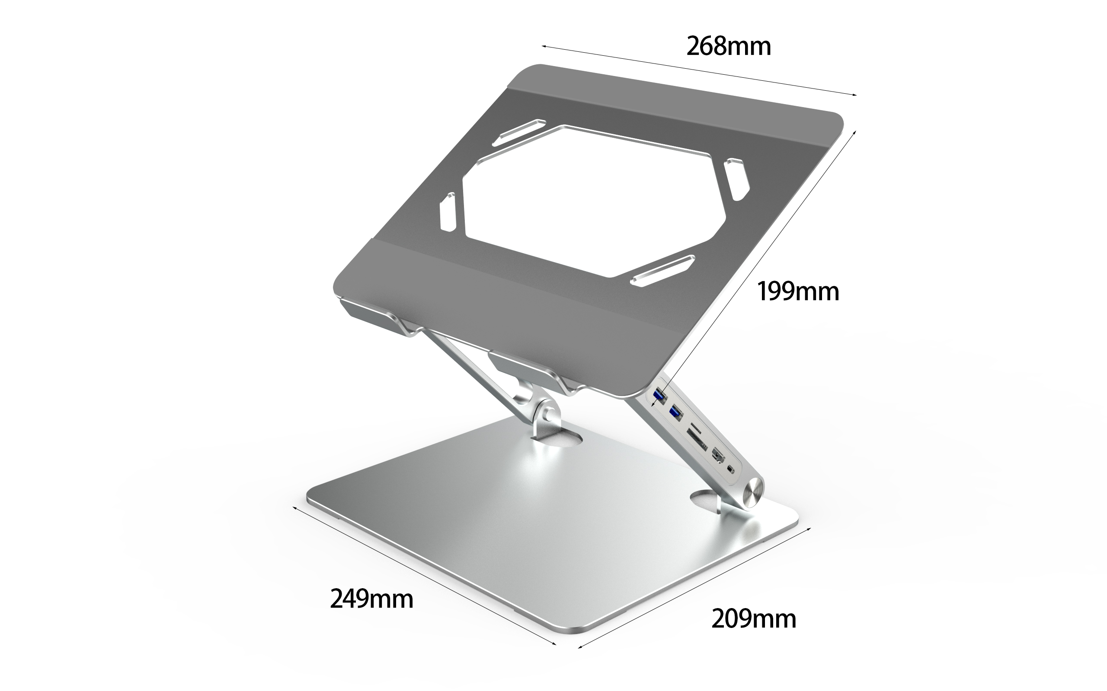
EILI: 6 in 1Universal Adjustable Ergonomic Laptop Riser Docking Station with PD USB-C, USB-A*2, HDMI 4K30, Tabletop Desk Stand Power Hubs, Laptop Riser Compatible for 10-17" Laptop
Brand | EILI or Private Label
Color | Space Gray; Silver; Dark Black are available
Hardware Interface | Type C, HDMI, USB 3.0, SD/TF
Compatible Devices | MacBook Pro, MacBook Air, Dell, HP, Surface, Lenovo
Total USB Ports | 2
Dimensions | 10.24 x 8.86 x 1.97 inches
Number of Ports | 6
Total HDMI Ports | 1
Wattage | 100.0 watts

Slide 7
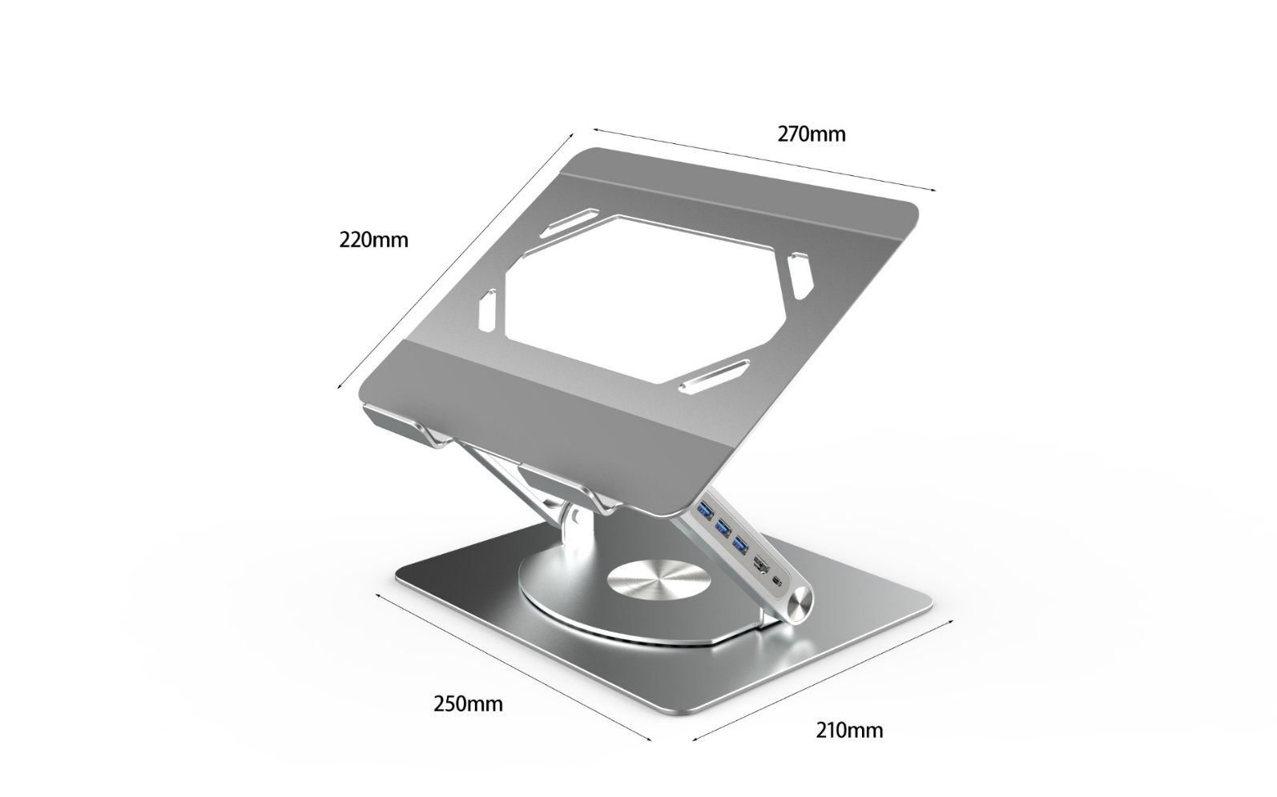
EILI: 5 in 1Universal Adjustable Ergonomic Laptop Riser Docking Station with PD USB-C, USB-A*3, HDMI 4K30, Tabletop Desk Stand Power Hubs, Laptop Riser Compatible for 10-17" Laptop
Brand | EILI or Private Label
Color | Space Gray; Silver; Dark Black are available
Hardware Interface | Type C, HDMI, USB 3.0,
Compatible Devices | MacBook Pro, MacBook Air, Dell, HP, Surface, Lenovo
Total USB Ports | 3
Dimensions | 10.24 x 8.86 x 1.97 inches
Number of Ports | 5
Total HDMI Ports | 1
Wattage | 100.0 watts

Slide 8
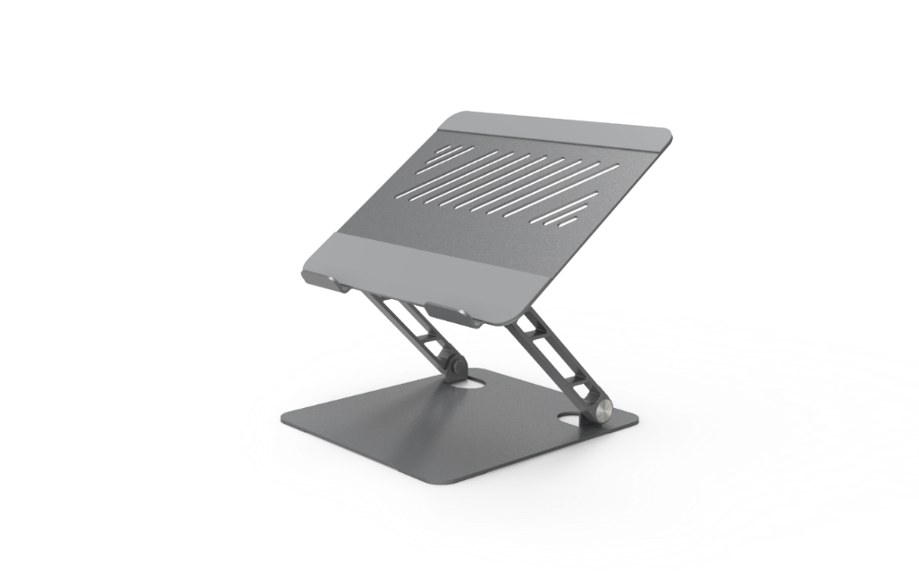
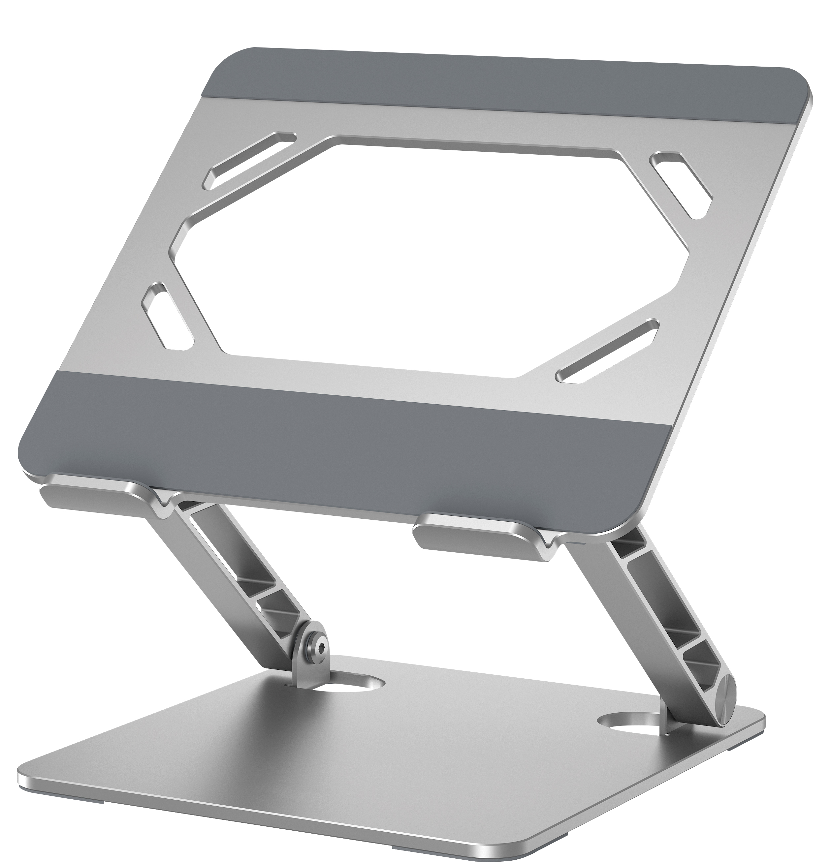
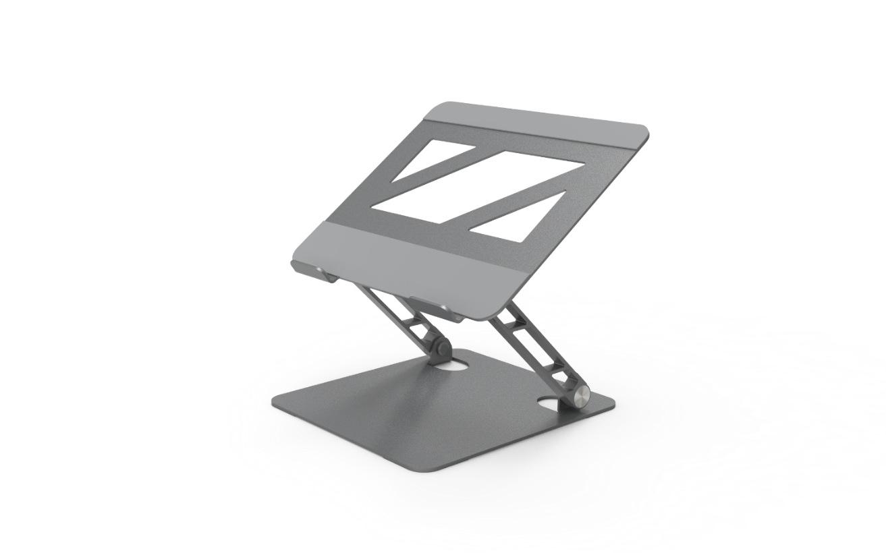
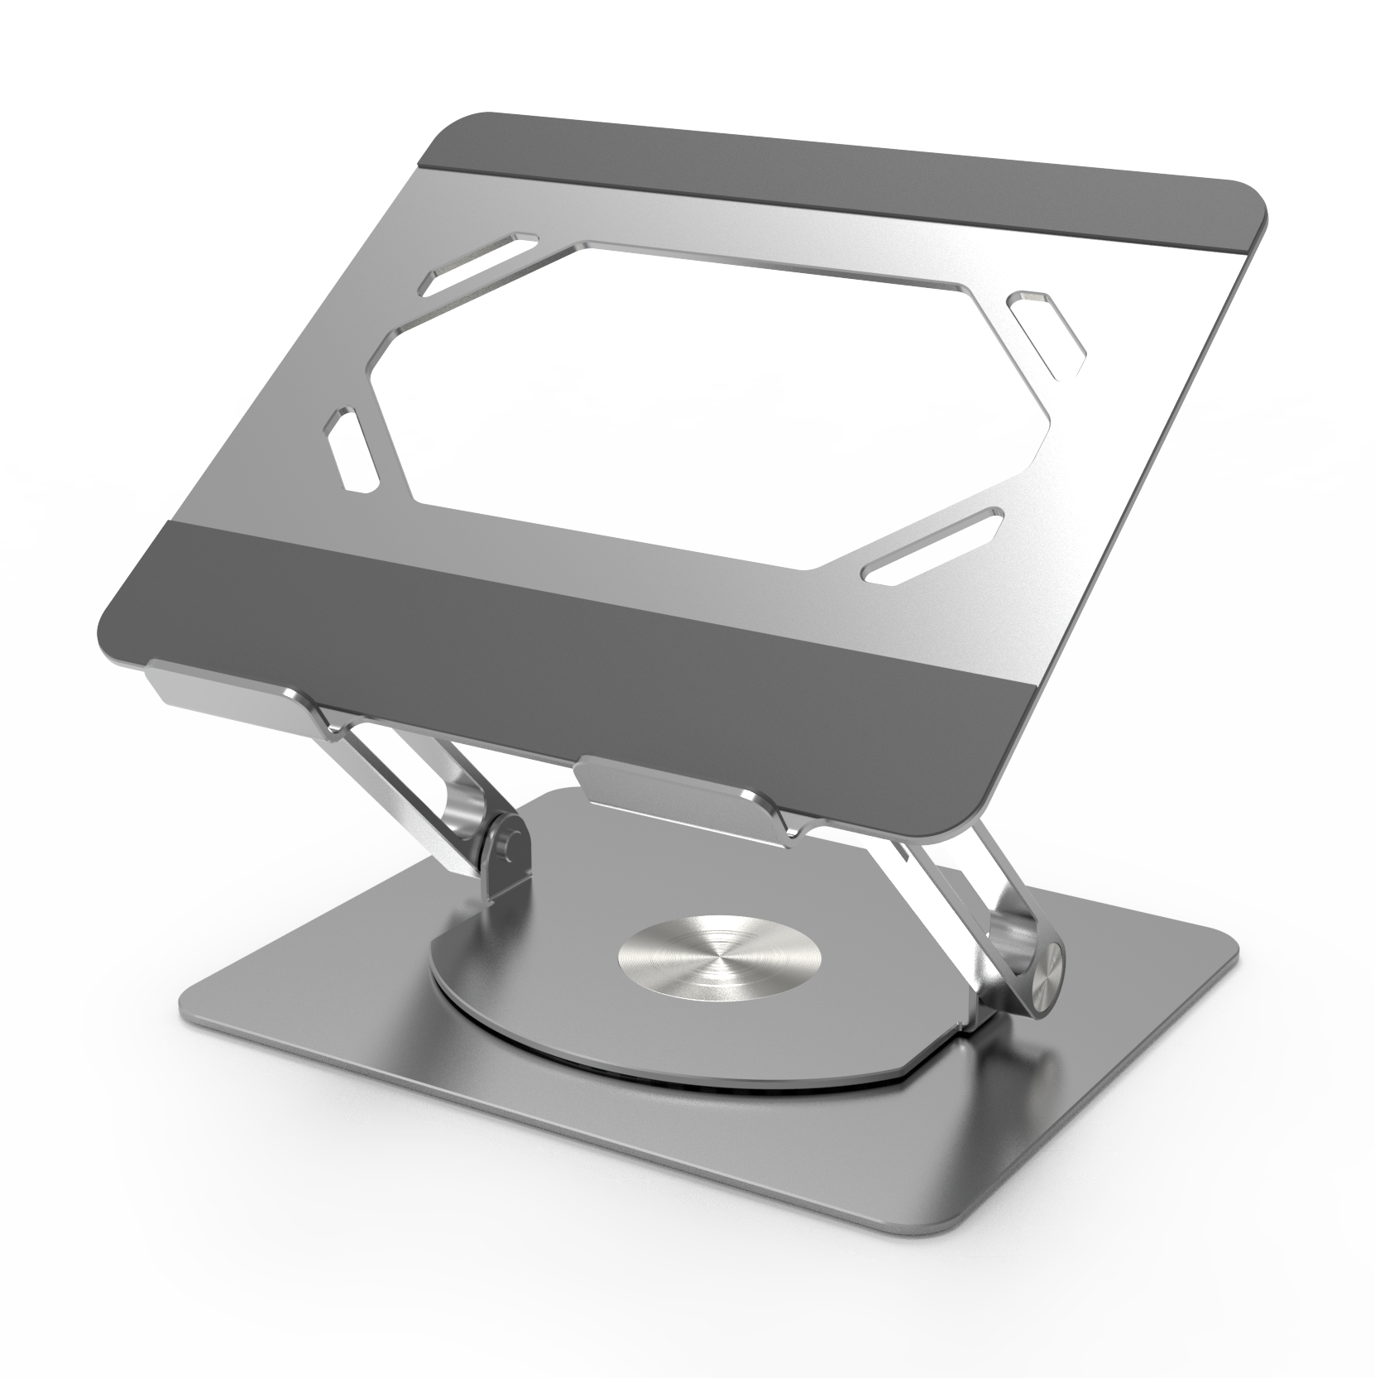
EILI: Laptop Stand, Adjustable Laptop MacBook Stand for Desk, Ergonomic Aluminium Computer Stand with Heat-Vent, Laptop Riser Compatible for 10-17" Laptop
Brand | EILI or Private Label
Color | Space Gray; Silver; Dark Black are available
Form Factor | Z-type
Compatible Devices | Laptops, MacBook
Compatible Models | Ipad, ipad pro, mircosoft surface , surface pro, dell , hp, Mac book
Mounting Type | Tabletop
Material | Aluminum
Special Feature | Adjustable Z-type Stands, Match MacBook Style
Recommended Uses For Product | Desk
Dimensions | 10.24 x 8.86 x 1.97 inches

Slide 9
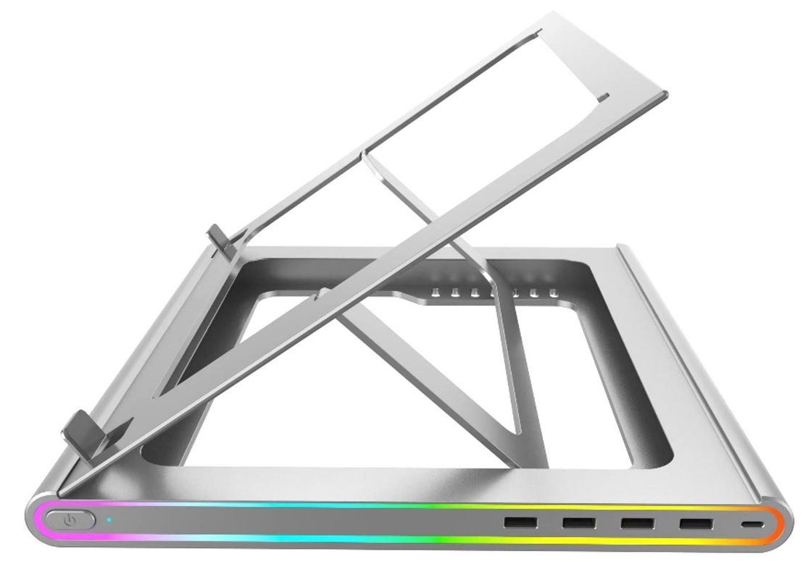
EILI: RGB Laptop Stand for Desk with 4 Port USB 3.0 Hub, Type C Power Delivery Ergonomic Anti-Slip Computer Stand Holder, Type C Cable, 10 RGB Modes, Aluminium Notebook Stand Laptop Riser Compatible up to 17.3" Laptops
Brand | EILI or Private Label
Color | RGB Laptop Stand
Compatible Devices | Laptops, MacBook
Mounting Type | Tabletop
Material | Aluminium, Rubber
Special Feature | 4 Port USB Hub, 3.0 RGB ( Tailor Made to customers) USB Type C Power Delivery (up to 100W)
Recommended Uses For Product | Desk
Item Dimensions LxWxH | 9.1 x 10.3 x 3 inches

Slide 10
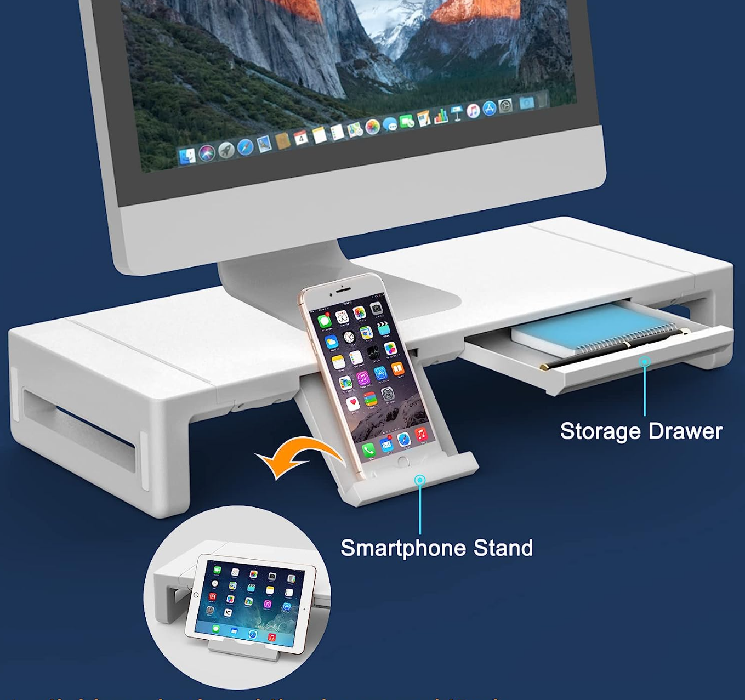
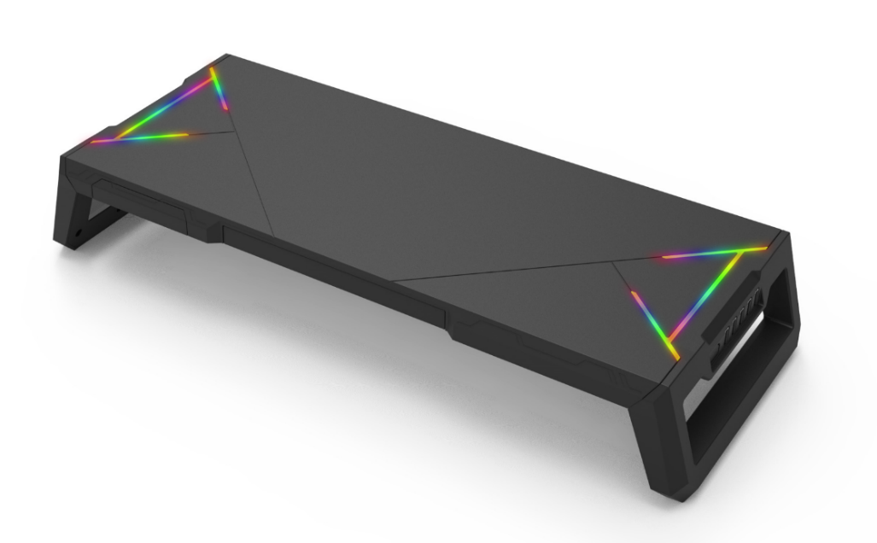
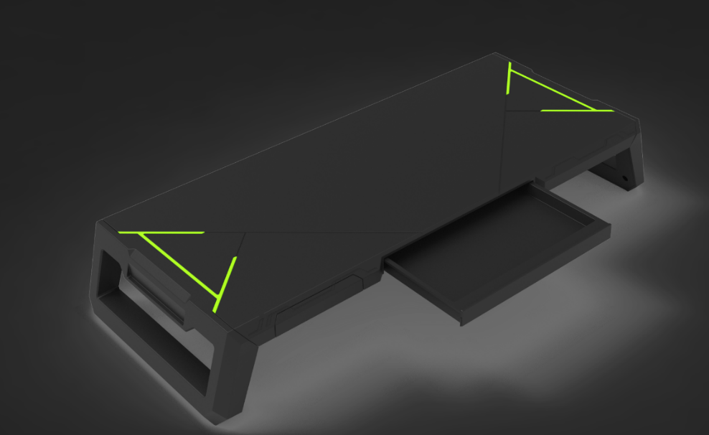
EILI: Monitor Stand Riser with Drawer & RGB, Width Adjustable Computer Stand Desk Organizer with Storage,Monitor Riser for Laptop and PC Printer
Color | WHITE/BLACK
Material | White 4 USB Ports
RGB | YES (can have tailor Made to Customers)
Brand | EILI or Private Label
Base Type | Pedestal
Assembly required | No
Load Capacity | 55 Pounds
Number of Levels | 3

